Slide 1
Modernized CX
Transitioning from “reviews” to relevance

Slide 2


The Best UX is Invisible
Devices sync instantly without user input (e.g. AirPods, iCloud).
Security codes and suggested actions surface before you search for them.
UX is so intuitive it feels obvious – no user manual needed.
Brand trust comes from consistency and simplicity across all products.
Orders start automatically when you’re nearby (app-based anticipation).
You’re greeted warmly – every time. “My pleasure” culture.
Staff are empowered to solve problems fast, without escalation.
Loyalty is built through operational consistency and culture of care.

Slide 3


The Best UX is Invisible
Recommends exactly what you’re likely to need – before you look for it.
One-click checkout, tracking updates, and auto-refunds remove all hassle.
Subscriptions arrive before you even think to reorder.
Customer service is fast, no-questions-asked, and never makes you beg.
Loyalty is driven by speed, reliability, and predictive convenience.
You trust the value – there’s no need to compare prices or shop around.
Limited choices reduce analysis paralysis and build confidence in what you buy.
Membership creates identity – loyalty feels earned, not manipulated.
Every element of the experience feels intentional. Not designed to sell, but to serve.

Slide 4
Why Do These Brands Create Such Loyalty?
Does Chick-fil-a have the best chicken you could possibly buy? Then why is it the most beloved chicken restaurant in the world?
They consistently try to make you feel like the most important person in the world.
Is Apple the only company that makes smartphones and computers? Then why do people line up and wait hours to pay a premium – year after year?
It’s the only one that feels like it was made just for you.
Does Amazon have the best batteries, socks, and household goods in the retail industry? Then why is it the default for millions of people every single day?
It’s the only one that makes it effortless every single time.
Is Costco the cheapest store in America? Is it the flashiest store in America? Then why do people gladly pay to just walk in the door?
It’s the only one you trust without needing to second-guess.

Slide 5
The most referable brands anticipate needs before anyone knows to ask.

Slide 6
The Way We Worked No Longer Works
Our clients don’t struggle with information
They struggle with knowing what matters now
Review meetings tell them where they’ve been
Clarity & confidence comes from knowing what’s next
The key foundational value proposition of a financial advisor is advice – not information transmission
Great CX makes the knowns obvious and the unknowns navigable.

Slide 7
The Hidden Cost of Review-driven Engagement
What the Old Model Was Built To Do
How That Shaped Our Behavior
Deliver consistent reviews aligned with B/D and corporate RIA requirements
Create documented touchpoints that satisfied oversight expectations
Use meetings as the primary compliance-safe delivery mechanism
Present plans, reports, and updates in a controlled setting
Maintain a predictable cadence that could be defended and audited
Meetings became the safest place to surface questions
Key decisions were intentionally deferred to follow-up, so judgment was applied between meetings, not during them
Advice migrated to emails and calls after the “official” review
Proactivity was constrained by the design – we became mostly reactive
Over time, the structure itself began to feel like value justification – rather than the actual client outcomes
Our most valuable advice often lurked in the shadows of follow-up.

Slide 8
CX is a System, Not a Tool
What We Mean By Design
What We Aren’t Talking About
How prepared we are before a conversation starts
How clearly we frame what actually matters
When a meeting earns its place
How updates and context move without a call
Who is thinking ahead before a decision shows up
Clear segmentation, so the right solutions find the right clients
A shiny new app that fixes everything and replaces all engagement
A different meeting quota
More process for the sake of process
Asking people to just “be more proactive”
Status quo checklists and meeting topics
CX is how we show up, day to day.

Slide 9
Where Clients Feel the Difference
Decisions don’t feel last-minute
Conversations feel relevant, not routine
Fewer “did we think of everything?” moments
Less explaining, more deciding
They don’t have to tee up the conversation
They don’t feel like they’re starting from scratch
Confidence shows up before outcomes do
They don’t wonder if we’re seeing the full picture
Clients feel the difference when they stop feeling like they need to periodically manage the relationship.

Slide 10
Where the Team Stops Creating Work for Themselves
Fewer prep tasks created because a meeting objective wasn’t clear
Clear follow-up tasks because the meeting outcomes were clear
Less follow-up on things we could’ve prepared for ahead of time
Less prep for conversations that never end up happening
Fewer handoffs caused by “let’s circle back on that”
Team members feel the difference because clear objectives & outcomes create clear work. Everything else is noise.

Slide 11
Client Segmentation
How we determine the scope of engagement for each client

Slide 12
What is a “Segment,” really?
Each segment reflects:
how involved we are in planning decisions
how much judgment is expected over time
how broadly we engage across the client’s world
Not:
how many meetings occur
how many deliverables are produced
how large the portfolio is
Importantly, we aren’t just segmenting for today’s clients – we are segmenting for the future client roster
Again, segments describe responsibility and engagement derived from the fees clients pay us.

Slide 13
Shift: Inputs & Outcomes
Current CX
New CX
Inputs:
  Review Meetings
  Scheduled Calls
  Incoming Client Needs
Outputs:
  Financial Plans
  Meeting Deliverables
  Follow-up Tasks
Inputs:
  Proactive Insights
  FP Updates
  Team Collaboration
Outputs
  Intentional Meetings
  E-mails
  Direct Messages
  Personalized Videos

Slide 14
Shift: Prescriptive Segmentation to Min/Max Segmentation
The Old Way
Min/Max Segmentation
Historically, segmentation prescribed activity.
  How many meetings.
  How many deliverables.
  How often we checked in.
That approach assumed uniform needs, and it broke as complexity increased.
As fiduciaries, we are good at identifying needs and recognizing the obligation to meet them.
However, without a ceiling or guardrails, this is where service creep happened
Going forward, segmentation defines bounds, not checklists.
For each segment, we clearly identify:
  the minimum responsibility required to deliver real value
  the maximum responsibility we are willing to accept within that segment and remain profitable
Inside those bounds, advisors apply judgment.
Outside those bounds, the engagement, and pricing, must change.
Going forward, segmentation will no longer prescribe service and deliverables. It defines responsibilities with clear minimums and maximums.

Slide 15
The New Segments
Legacy Segmentation (AUM-Based) | AUM Range | What It Functionally Represented | New Segmentation (Revenue-Based) | Annual Revenue Tier | What It Now Explicitly Represents
Silver | <$1M | Entry-level relationship | Fulfillment | <$7.5k | Limited planning responsibility
Gold | $1–2M | Core client | Essential | $7.5–15k | Core planning responsibility
Platinum | $2–3M | Upper core | Dynamic | $15k–22.5k | Ongoing judgment required
Diamond | $3–5M | High-touch | Collaborative | $22.5–30k | Shared planning responsibility
Signature | $5M+ | “Top tier” | Bespoke | $30-65k | Highly customized planning responsibility
Signature+ (Negotiated) | $10–25M+ | UHNW / exceptions | Access | $65k+ | Continuous planning responsibility with access to all resources – we have a “seat at the table” with the family
Notes:
Easiest way to begin finding your segment parameters is to review your current book of business first

Slide 16
Min/Max Service Guardrails
Purpose: Set clear guardrails so engagement stays equally valuable to the client and profitable to the business while preserving advisor judgment (multiple lanes) and allowing thoughtful exceptions (off‑ramps).
Minimum responsibility (MIN): The baseline we always deliver to create real value. Accurate plan inputs, core coverage (cash flow/taxes/estate/insurance), timely touches around known triggers, and clear follow‑through. THINK: "If this same client went elsewhere, what kind of service would they receive?"
Maximum responsibility (MAX): The ceiling we won’t exceed within a particular segment without a scope/pricing change. Ex: open-ended access expectations, customized everything, deep third‑party coordination beyond defined bounds, high-frequency transactions.
Department guardrails (to be finalized): Each team (Advisory, CST, Ops/Trading, Client Service) defines its MIN and MAX with examples that map to segment responsibility.
How we measure: CRM exports for now; additional tracking as technology improves/utilizing AI
Outside the bounds: re‑scope engagement and pricing before proceeding.
Inside the bounds: advisors use judgment to choose channel (sync/async), timing, and depth; CST equips advisors with targeted prep.
Outside the bounds: thoughtful, intentional, bounded exceptions

Slide 17
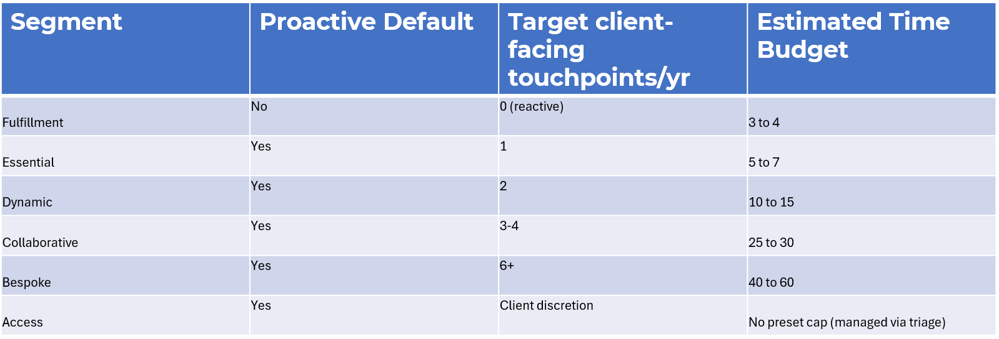
Min/Max Guidelines

Slide 18
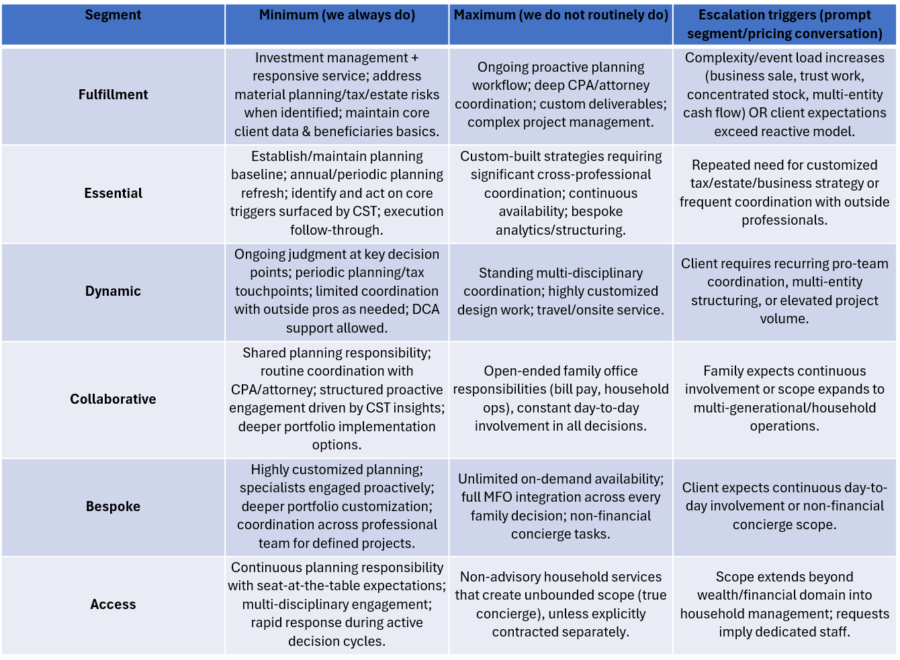
Min/Max Segment Responsibility Bounds

Slide 19
Proactive Client Touches
Advisor-initiated:
Use Touch Point Tracker
calendar touchpoints
Choose channel (sync/async)
Each touch has a clear purpose
CST-initiated:
Monday huddle
Touch Point Tracker
Proactive Opportunities sheet
CRM & other tools
Advisor triage (60-second test)
• Light prep? Advisor handles (often async)
• Deeper planning if ANY:
– RightCapital scenarios
– Specialist judgment
– Time-sensitive/material decision
– Multi-stakeholder alignment
Prep examples
• Portfolio: acct summary, Ycharts
• Cash-flow: RC, YRP
• Planning: RC, HP, FPPath
Conversation channel decision
Default to async email/video unless:
• Material/irreversible
• Multi-party alignment
• High emotional stakes
• Live judgment adds value
• Direct client request
Notify CST via Teams
Required fields:
• Client/HH & Segment (A–F)
• Reason: Portfolio, Cash Flow, Planning
• Urgency: Now | Soon | Normal
• Objective & desired outcome
• Deadlines/constraints
• Links/attachments
Close the loop
• Log notes & action items in RT
• Future proactive outreach
Ultimate goals: move from reviews to relevance; anticipate the client’s needs; true client segmentation; advisors be advisors; CST provide insights & depth; meeting earns its place

Slide 20
Reactive Client Touches
Client initiates contact
• Portfolio update/news
• Cash-flow decision (contrib/distribution/rollover)
• Planning question (life/event/equity comp)
• Admin request (forms/beneficiaries/ address change)
CST triage & assignment
• Assign owner (Para/Specialist/Senior)
• Acknowledge ETA per segment/urgency
• Prep should be impactful (no generic reviews)
Advisor triage (60-second test)
• Light prep? Advisor handles (often async)
• Deeper planning if ANY:
– RightCapital scenarios
– Specialist judgment
– Time-sensitive/material decision
– Multi-stakeholder alignment
Prep examples
• Portfolio: acct summary, Ycharts
• Cash-flow: RC, YRP
• Planning: RC, HP, FPPath
Notify CST via Teams
Required fields:
• Client/HH & Segment (A–F)
• Reason: Portfolio, Cash flow, Planning
• Urgency: Now | Soon | Normal
• Objective & desired outcome
• Deadlines/constraints
• Links/attachments
Conversation channel decision
Default to async email/video unless:
• Material/irreversible
• Multi-party alignment
• High emotional stakes
• Live judgment adds value
• Direct client request
Close the loop
• Log notes & action items in RT
• Future proactive outreach
Ultimate goals: move from reviews to relevance; anticipate the client’s needs; true client segmentation; advisors be advisors; CST provide insights & depth; meeting earns its place

